Slide 1
Metadata for Improving Commercialisation of Dynamic Tourist Packages
Esteve Lladó *, Idoia Murua **, Bel Llodrà *
Fundación IBIT (*), ROBOTIKER (**)
DC-2005 (Madrid, September 2005)
International Conference on Dublin Core and Metadata Applications

Slide 2
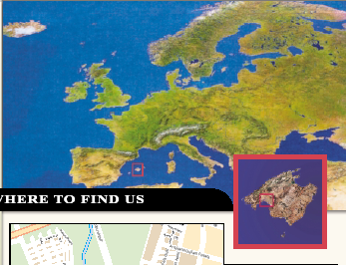
Fundación IBIT
Information Technology R&D Center located in Palma de Mallorca

Slide 3
ANOTA project
This pilot experience is partially funded by the ANOTA project.
Partners:
- Fundación IBIT (coordinator)
- Fundación Robotiker
- Instituto Andaluz de Tecnología (IAT)
- Unviersitat Oberta de Catalunya (UOC)
Funding: Education and Science Ministry (PROFIT program)

Slide 4
Business Scenario:
Dynamic Packaging in travel industry
Definition of Dynamic Packaging:
“An industry buzzword for enabling the consumer (or booking agent) to build a customized itinerary by assembling multiples components of their choices and complete the transaction in real time.” (Stephanie Lofgren)

Slide 5
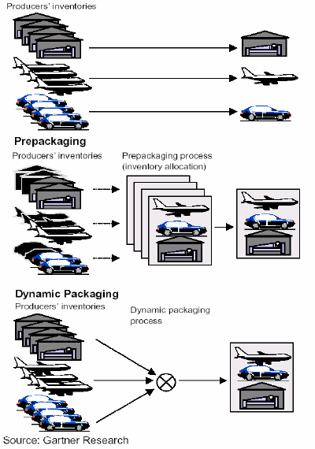
Dynamic Packaging vs Pre-packaged travel
Tourist Providers
1. Traditional model:
Prepackaging
- Fixed options
- Inflexible dates
- Made months in advance
2. New model:
Dynamic Packaging
- Flexibility
- Customization
- Single point of contact

Slide 6
Dynamic Packaging: required features
Access to a wide choice of supplier products
The ability to search for and to aggregate these components
The ability of having the pricing of the package done by a trustworthy system/engine in real time by applying discount rules to the combined components.

Slide 7



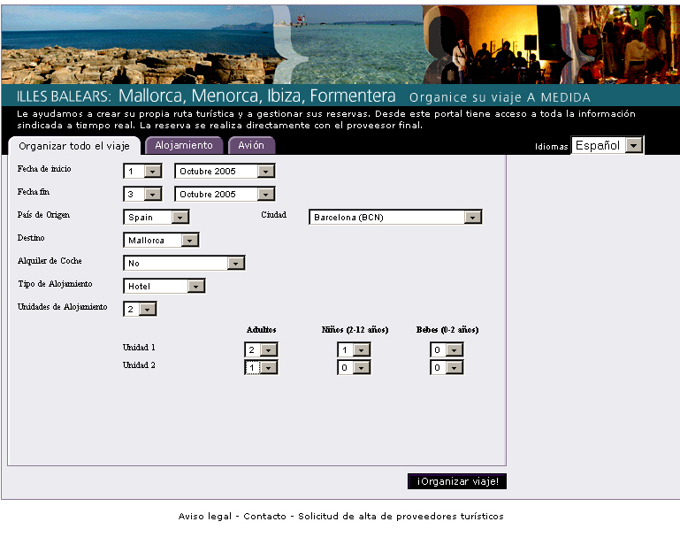
General view of the process
Administrator
Information sources
Administration
tool
(1) registering
RDF/XML
Sources
directory
(2) discovering
(3) downloading RDF/XML data
Aggregation
system
(4) presenting
aggregated content
End Users
Metadata
repository

Slide 8
Ontology creation
Description of the Tourism Domain (tourist resources and zones, availability info).
Ontology reuse: - OTA (Open Travel Alliance) data model,
- GML (Geography Markup Language)
Protege 3.0 (with RDF backend plug-in)
RDF Schema
Metrics: 164 classes, 74 slots

Slide 9
Metadata repository
Sesame 1.2.1 (Aduna BV, openrdf.org)
SeRQL query language
Concept of Repository

Slide 10
Metadata creation
Two kinds of information sources (depending on the owner)
Cooperative owner Non-cooperative owner
Transforming XML to RDF
Screen-scraping techniques

Slide 11
Metadata creation: cooperative owner
External information source
XML
XSLT
RDF/XML -1 (original source model)
SeRQL-C (graph transformation)
RDF/XML -2 (Tourism Domain Ontology)

Slide 12
Metadata creation: non-cooperative owner
HTML
XHTML
XSLT
RDF/XML -1 (original source model)
SeRQL-C (graph transformation)
RDF/XML -2 (Tourism Domain Ontology)

Slide 13
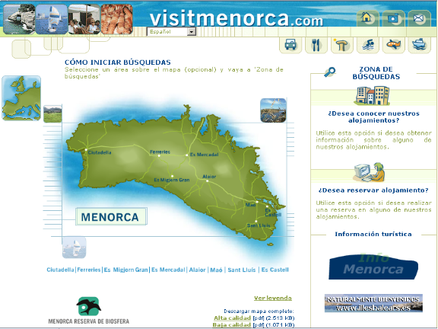
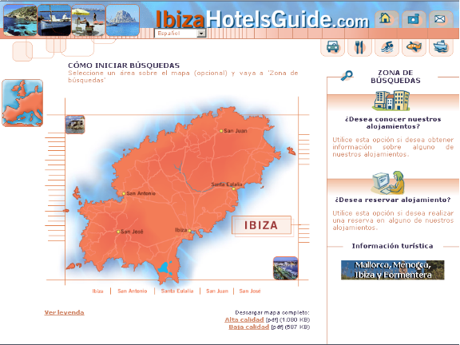
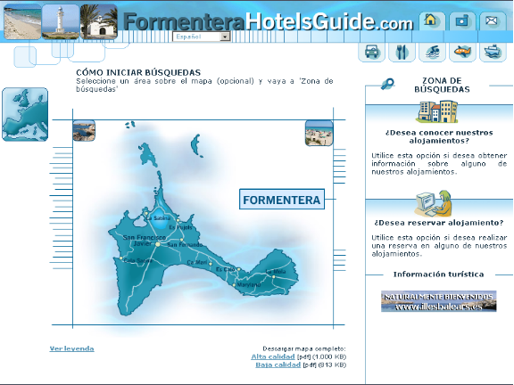
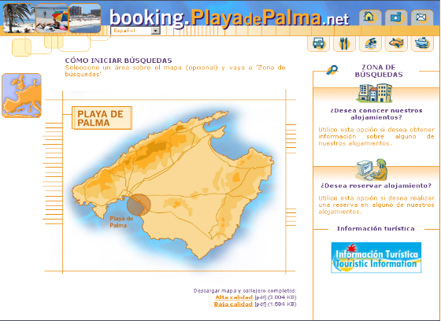
Metadata creation from booking systems
www.visitmenorca.com
www.ibizahotelsguide.com
www.formenterahotelsguide.com
booking.playadepalma.net

Slide 14
Administration tool
Registration of information sources in the directory
    URL of the source
    Tourist service type
    Geographical Area
    Service interface
Access to the directory via Web Service
    Semantic Look-Up (service type and geo. area)

Slide 15
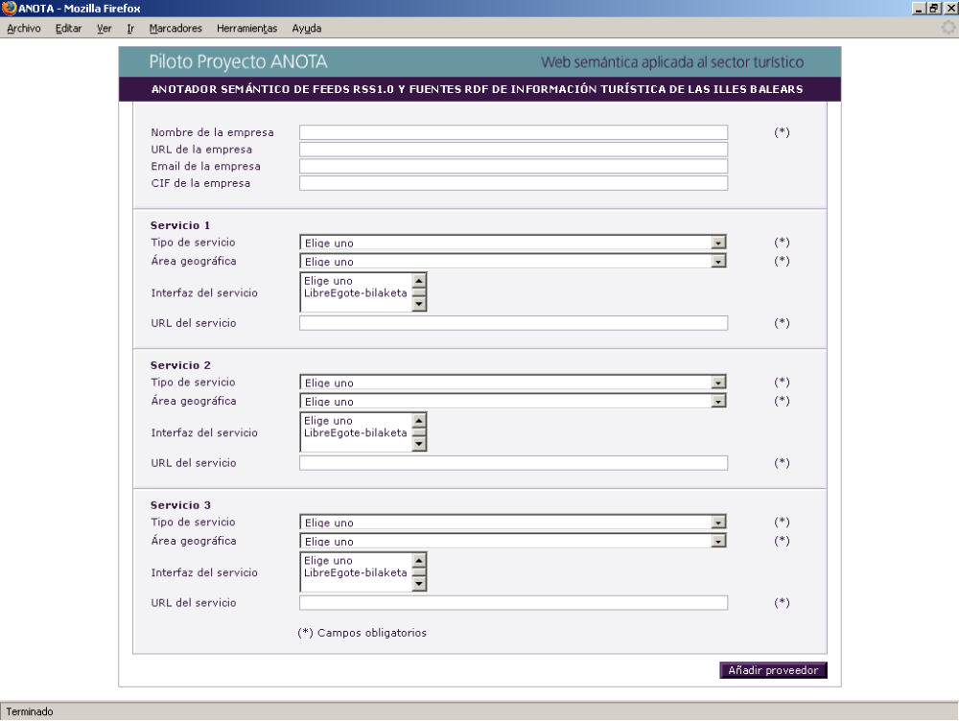
Administration tool: user interface

Slide 16
Content aggregation system: architecture
Creation of a temporal repository per user/session
RDF/XML
RDF/XML
RDF/XML
Repos. -
user-1
Repos. -
user-N
. . .
User 1
User 2
User 3

Slide 17
User interface:
Trip preferences selection

Slide 18
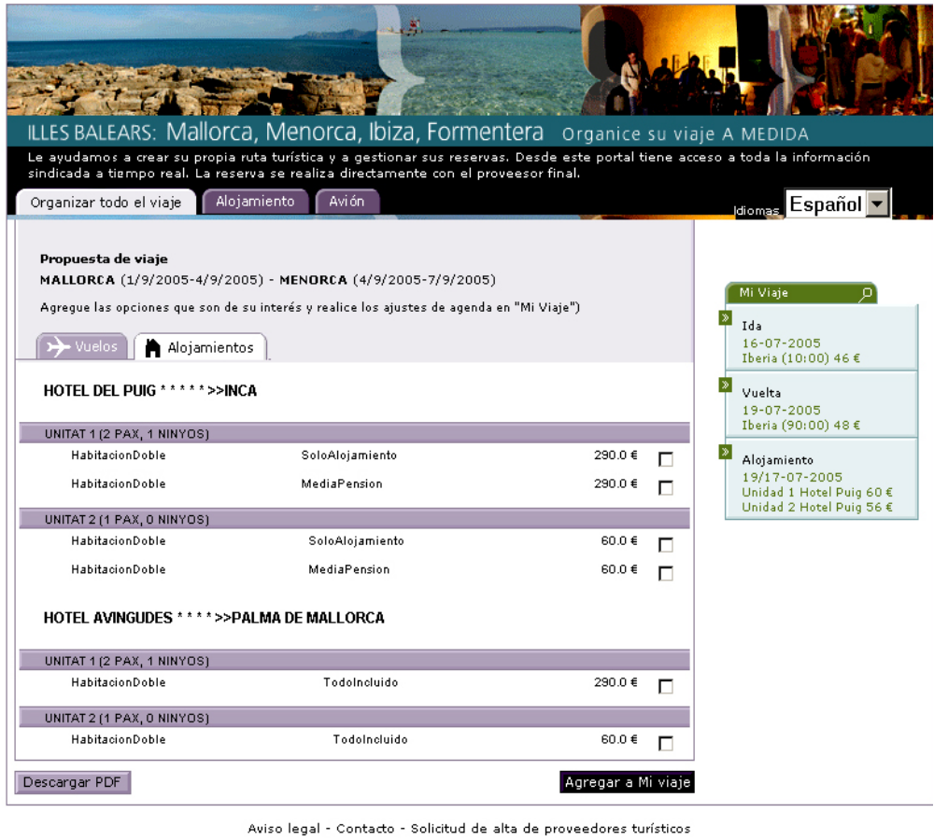
User interface: accommodations result list
Selected trip details

Slide 19
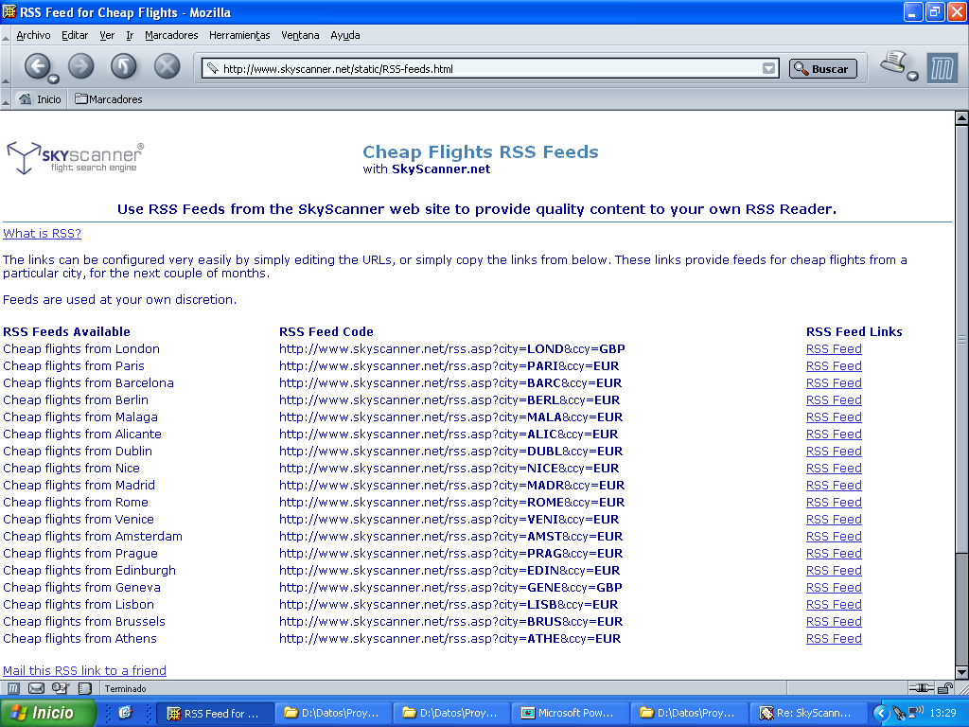
Flights offers as RSS Feeds

Slide 20
Extending RSS
To include metadata about special tourist offers (last minute offers ..)
Enabling RSS readers for Dynamic Packaging of special product offers.

Slide 21
Conclusions
Dynamic Packaging seems to be an interesting scenario for creating metadata applications and using Semantic Web technologies.
Exploration of future direction: Semantic Web Services vs Sesame mediator architecture to distribute SeRQL queries

Slide 22
Metadata for Improving Commercialisation of Dynamic Tourist Packages
Thank you for your attention
Esteve Lladó (ellado@ibit.org)

